Slide 1
Is Standardization Standard?
Elsy Hernández
University of Idaho

Slide 2
Notable Construction Standards and Organizations
Americans with Disabilities Act (ADA)
Occupational Safety and Health Administration (OSHA) Standards
American National Standards Institute (ANSI)
International Organization for Standardization (ISO)
American Society for Testing and Materials (ASTM) International Standards
American Society of Heating, Refrigerating and Air-Conditioning Engineers (ASHRAE)
American Society of Mechanical Engineers (ASME)
American Society of Civil Engineers (ASCE)
Institute of Electrical and Electronics Engineers (IEEE)
National Fire Protection Association (NFPA)
National Electrical Code (NEC)
International Code Council (ICC)
International Building Code (IBC)
International Residential Code (IRC)
International Plumbing Code (IPC)
International Fire Code (IFC)
International Mechanical Code (IMC)
International Energy Conservation Code (IECC)
Performance Code for Buildings and Facilities (ICCPC)

Slide 3
More...
International Association of Plumbing and Mechanical Officials (IAPMO)
Uniform Plumbing Code (UPC)
Uniform Mechanical Code (UMC)
Uniform Swimming Pool, Spa and Hot Tub Code (USPSHTC)
Uniform Solar, Hydronics and Geothermal Code (USHGC)
National Environmental Policy Act (NEPA)
American Institute of Steel Construction (AISC) Standards
American Concrete Institute (ACI) Standards
The Masonry Society: Masonry Standards Online (MSO)
International Code Council (ICC): International Existing Building Code (IEBC)

Slide 4
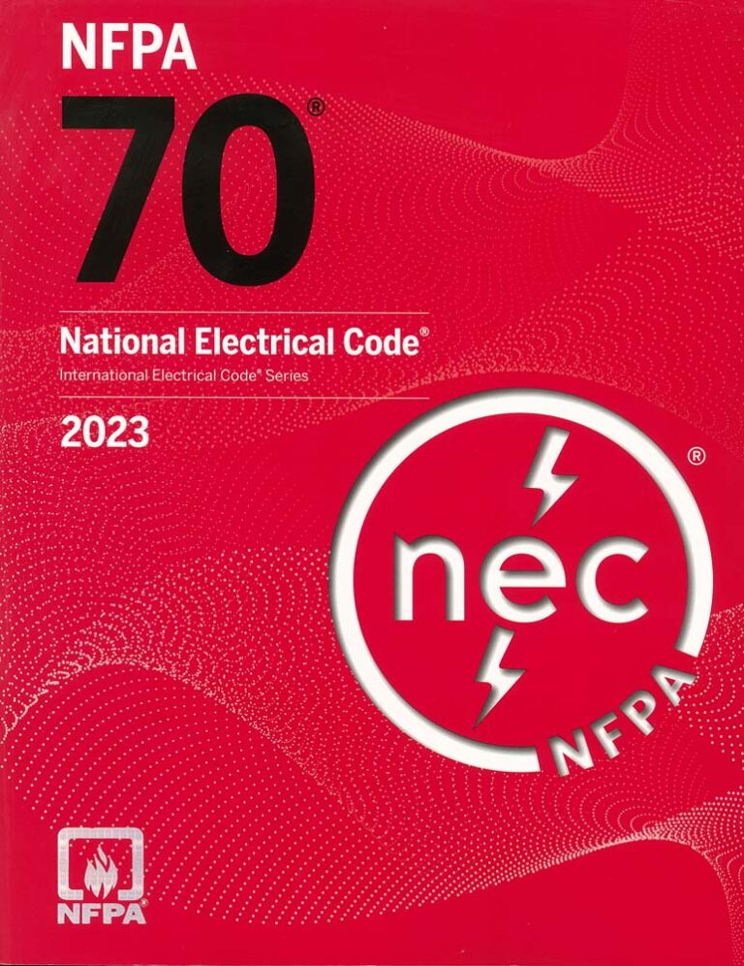
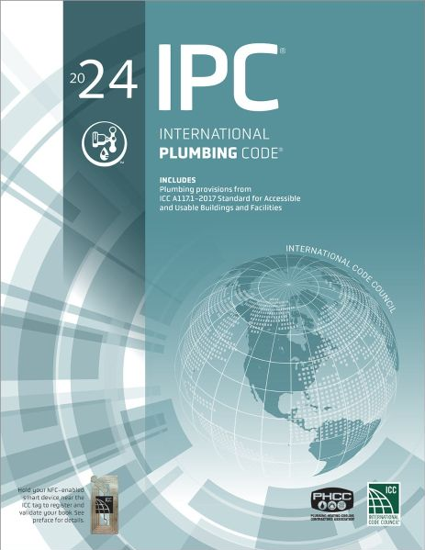
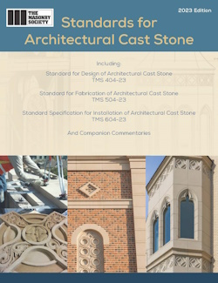

Slide 5
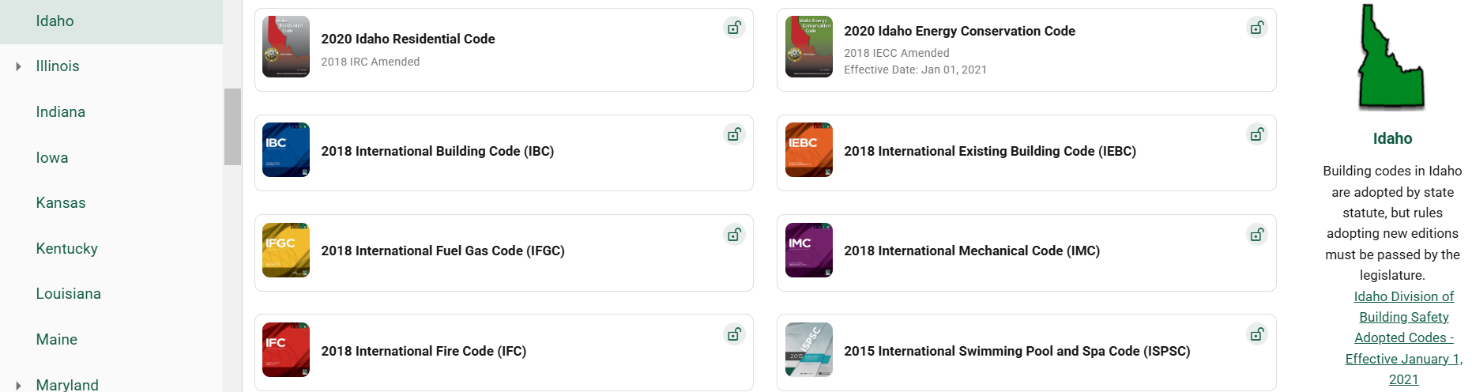
International Code Council: Idaho

Slide 6
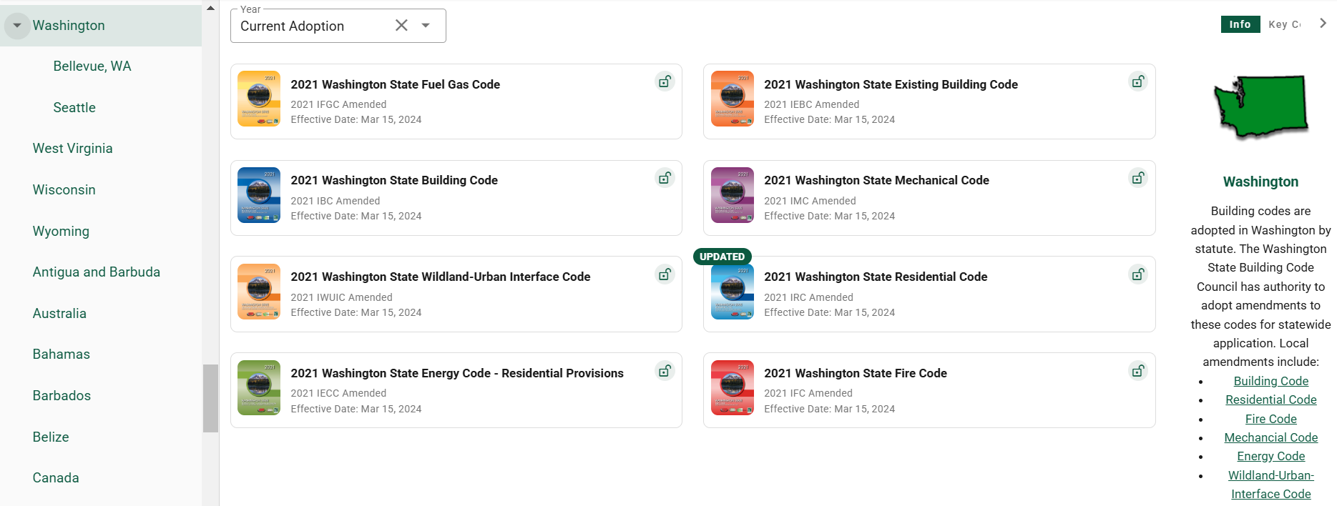
International Code Council: Washington

Slide 7
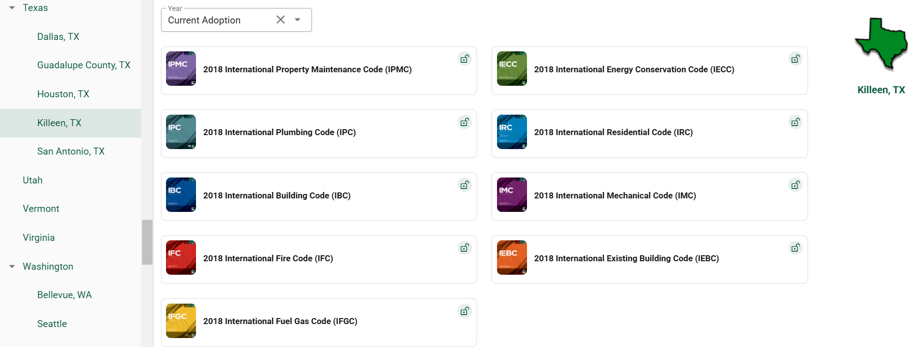

International Code Council: Texas

Slide 8
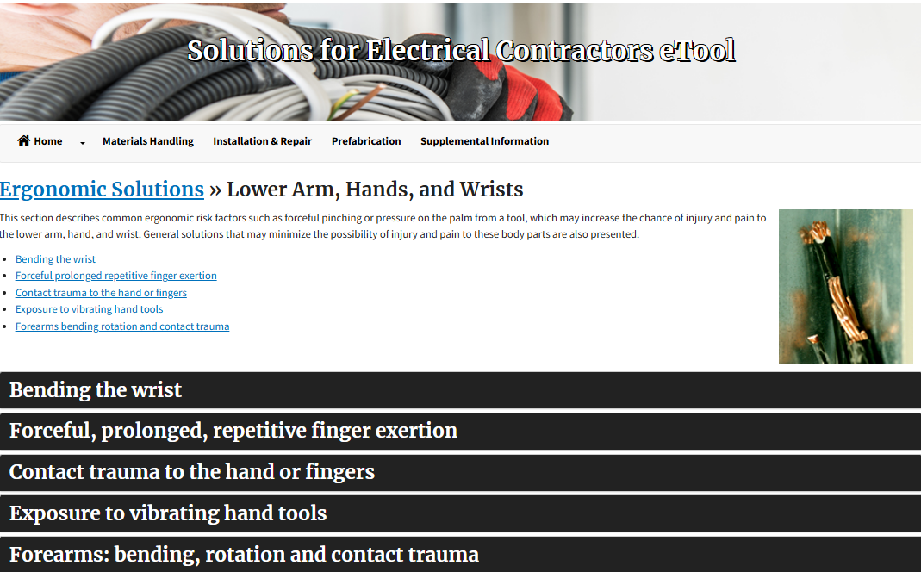
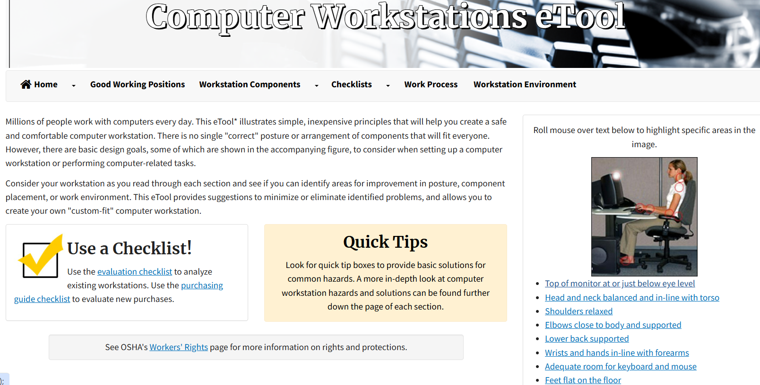
OSHA/NIOSH
Occupational Safety and Health Administration (OSHA)
National Institute for Occupational Safety and Health (NIOSH)
Manuals and Guidelines
Revised NIOSH Lifting Equation
Elements of Ergonomics Programs

Slide 9
More Collaborations
American National Standards Institute (ANSI)/Association for the Advancement of Medical Instrumentation (AAMI): Human Factors Engineering-Design of Medical Devices
American National Standards Institute (ANSI)/Human Factors and Ergonomics Society (HFES): Human Factors Engineering of Software User Interfaces
International Organization for Standardization (ISO)
International Ergonomics Association (IEA)
Human Factors and Ergonomics Society (HFES)

Slide 10
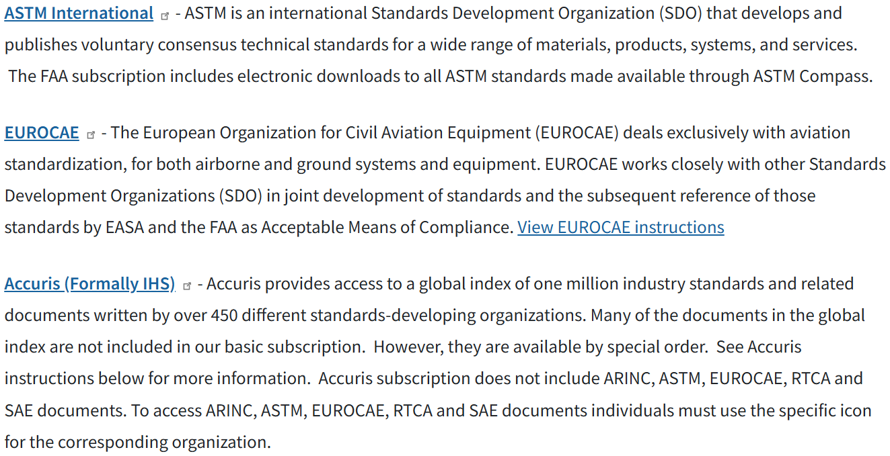
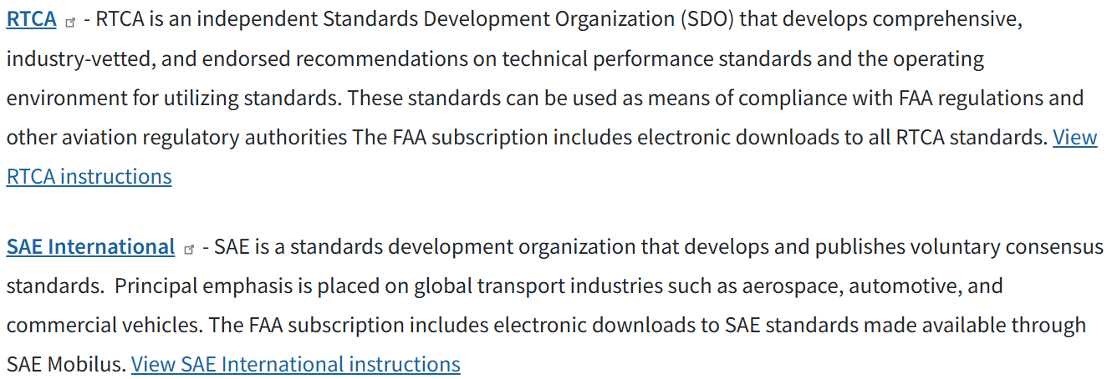
Federal Aviation Administration (FAA)
Publications
Technical Library

Slide 11
Thank You!

Slide 12
References
ANSI, & AAMI. (2018). Human Factors Engineering-Design of Medical Devices.
ANSI, & HFES. (2008). Human Factors Engineering of Software User Interfaces.
Federal Aviation Administration. (2024, April). FAA Technical Library Catalog. OPAC Discovery. https://f10011.eos-intl.net/F10011/OPAC/TileStart.aspx
Federal Aviation Administration. (n.d.). Browse Publications. FAA Human Factors (ANG-E25) Publications. https://hf.tc.faa.gov/publications/
Human Factors and Ergonomics Society. (2025). Technical Standards. https://www.hfes.org/publications/technical-standards
International Code Council. (2025). Standards. https://codes.iccsafe.org/codes/standards
International Ergonomics & Human Factors Association. (n.d.). International Ergonomics Association | Global Federation of Human Factors/ergonomics societies. https://iea.cc/

Slide 13
References Continued
International Organization for Standardization. (2025). Standards. https://www.iso.org/standards.html
National Institute for Occupational Safety and Health. (2024a, February 21). Revised NIOSH Lifting Equation. Centers for Disease Control and Prevention https://www.cdc.gov/niosh/ergonomics/about/RNLE.html
National Institute for Occupational Safety and Health. (2024b, February 26). Elements of Ergonomics Programs. Centers for Disease Control and Prevention. https://www.cdc.gov/niosh/ergonomics/ergo-programs/index.html
Occupational Safety and Health Administration. (n.d.-a). Computer workstations eTool. https://www.osha.gov/etools/computer-workstations
Occupational Safety and Health Administration. (n.d.-b). Ergonomics. https://www.osha.gov/ergonomics/
Occupational Safety and Health Administration. (n.d.-c). Solutions for Electrical Contractors eTool. https://www.osha.gov/etools/electrical-contractors/supplemental- information/solutions/tasks-hand

